Slide 1
New link create for Hyundai Division
Admin setup.
User setup.
Remove dash board option from user menu as Altab told.

Slide 2
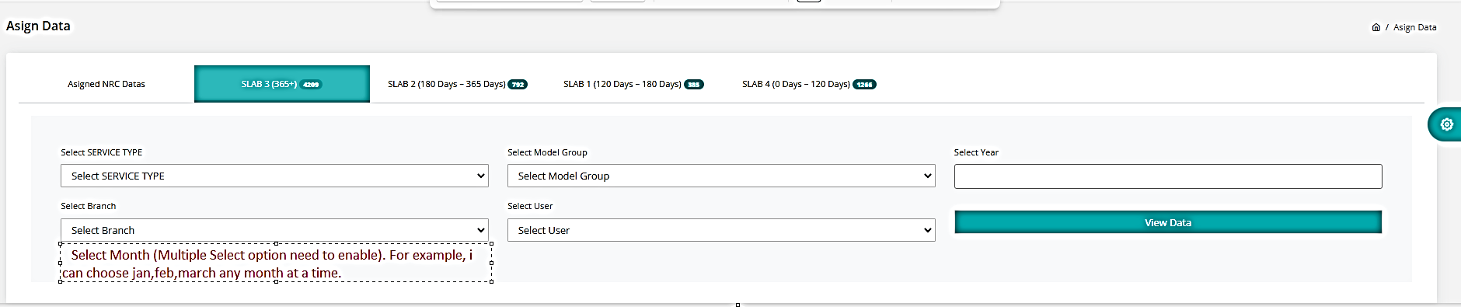

Slide 3
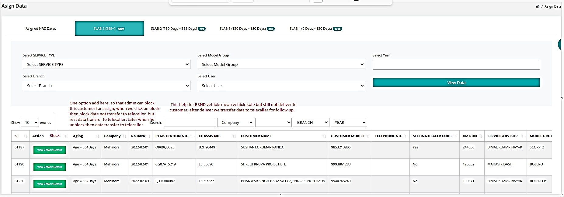

Slide 4
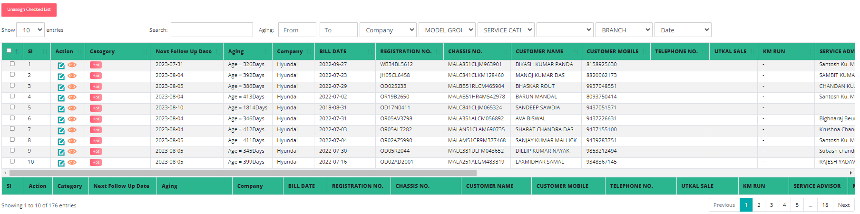
Company and service category option interchange area.
Option not working.
Option Add
UTKAL SALE (Yes, No)

Slide 5
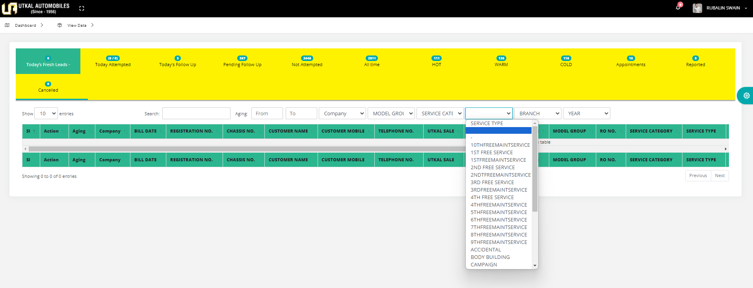
Option not working, auto reset, its not fixed with service type like service category.

